Slide 1
Capstone
Happiness Plus 1
A game by Jeff Redmond
https://github.com/jeffredmond/Ense400

Slide 2
What is my capstone?
Happiness plus 1 is a single player, 2D, top down view, puzzle solving, Role playing game.

Slide 3
About the story
The story is about a character who has fallen into an unfamiliar world
They learn that the only way for them to progress though the world is for them to help the NPCs around them remember their own pasts.
Helping the other characters in turn makes you feel happier, increasing your characters happiness causes you to transfer to the next level.
As the game progress your character begins to remember more of their own past and how they ended up coming to this world in the first place.

Slide 4
About the story
The messages that I will attempt to get across
What different things that cause people to be sad and the effects of that
One of the best ways to overcome your own internal struggles is though the help of others
How helping others is a major part in the pursuit of happiness

Slide 5
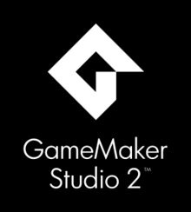




Tools that were used

Slide 6
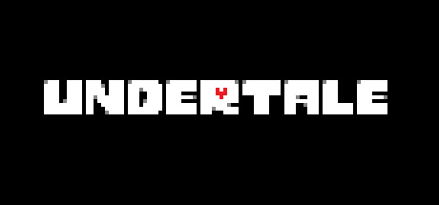

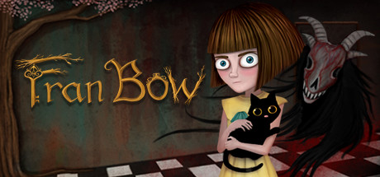
Inspirations

Slide 7
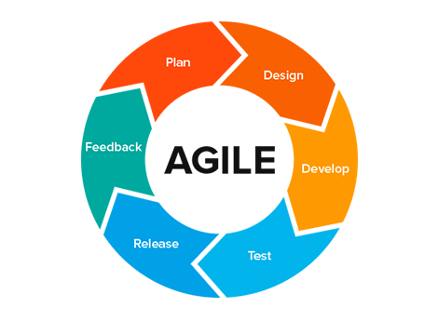
Software methodology used
Agile methodology was used:
Fall semester we used bi-weekly sprints
Start of winter semester was still bi-weekly sprints that then degraded into weekly then this last month or so every few day sprints

Slide 8
Time tracking
Fall semester a google document was used to keep track of meeting minutes as well as upcoming tasks.
Winter semester these task were taken over by a oneNote due to convenience and because my project partner had dropped out to the class so I was the only person who would have to access it

Slide 9
Break down of last two semesters
Fall semesters was spent:
Creating NPC Profiles/rough sketching them out
Creating Lofi levels
Storyboarding NPC interactions with the player
Writing the first draft of the Script

Slide 10
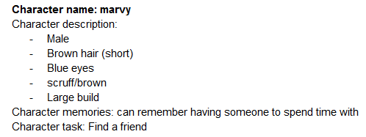
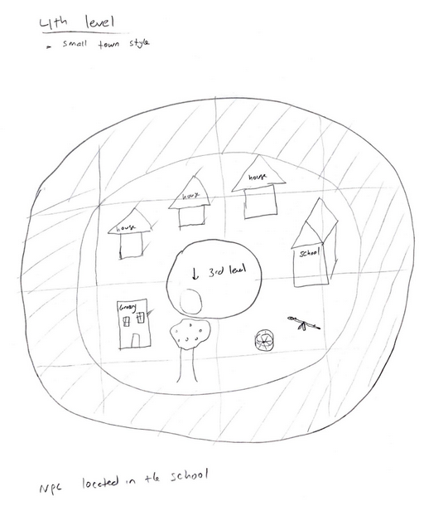
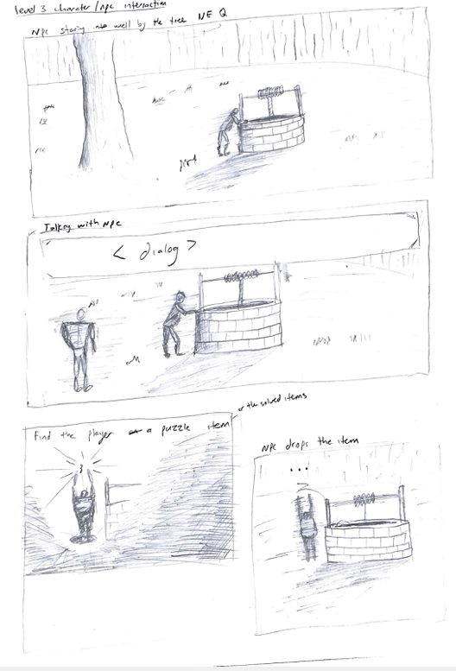
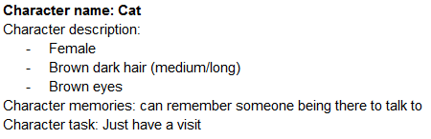
Break down of last two semesters
Fall semesters was spent:

Slide 11
Break down of last two semesters
Created a list of Requirements for the game.
Standard game Requirements
Needed the ability to move the character around a map
Ability to interact with items in a map
Save and loading functionality
Cutscenes
Audio (sound effects, music)
Interactions with NPC
Menu and start screen

Slide 12
Break down of last two semesters
More specialized game Requirements
The ability to craft items together
The ability to use normal items and crafted items to solve puzzles
A finished product that would have 9 levels

Slide 13
Break down of last two semesters
Started working with GameMaker studio 2.
Created a test room to start building the important objects
Player
Inventory
NPCs
Pause menu

Slide 14
Break down of last two semesters
Winter semesters was spent:
Created player walking animations and had a system to build new characters easily
Created an object that would create and control cutscenes
Added save and load functionality
Added room transfer objects

Slide 15
Break down of last two semesters
Overhauled the object for talking with NPCs
Added an object responsible for interacting with puzzle items
Added an object responsible for scenery that had descriptions

Slide 16
Break down of last two semesters
Created the first two levels
Drawing all the backgrounds
Drawing all the scenery
Drawing all the puzzle items
Creating all the cutscenes
Testing the game
Create the music for the title screens and intro cutscene in FL studio

Slide 17
Main features of the game
Game maker is built on self contained objects.
I will briefly go into all the objects and systems used in the game.

Slide 18
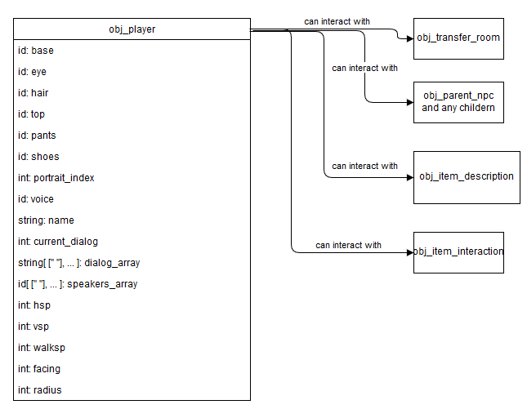
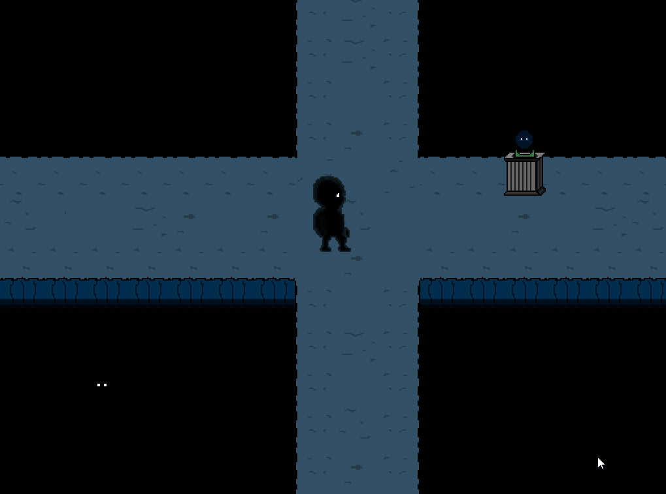
Main objects and systems implemented
Player object

Slide 19
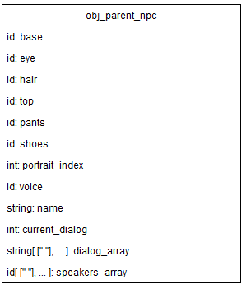
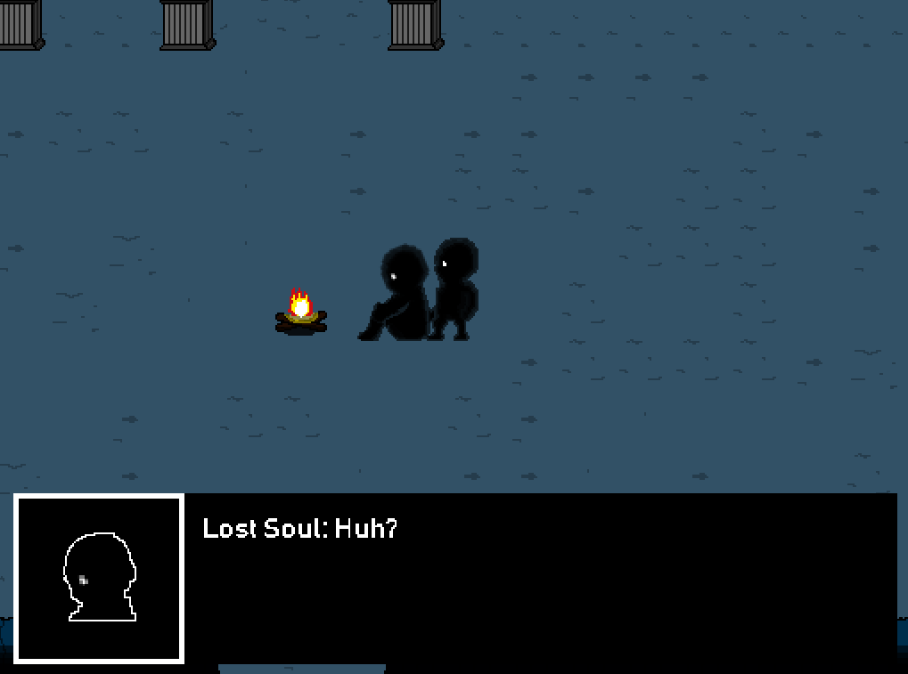
Main objects and systems implemented
NPC object

Slide 20
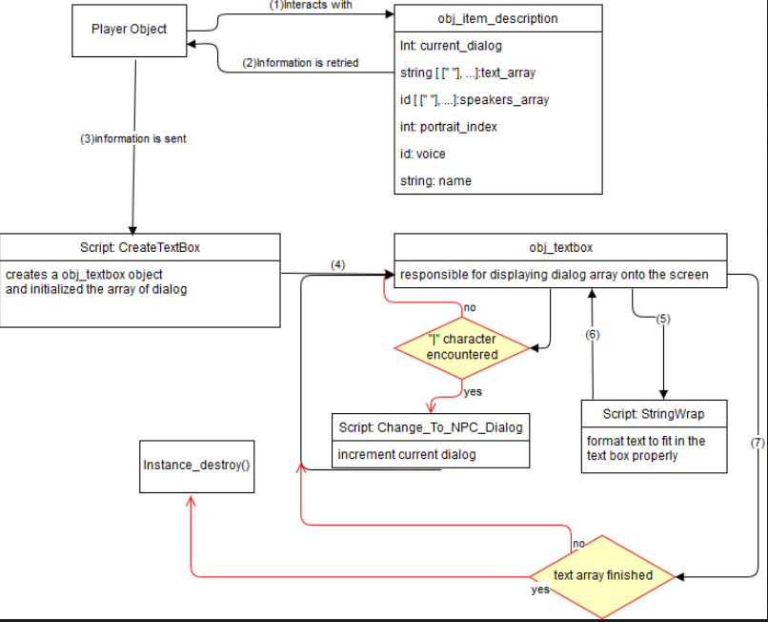
Main objects and systems implemented
NPC interaction and the textbox object

Slide 21
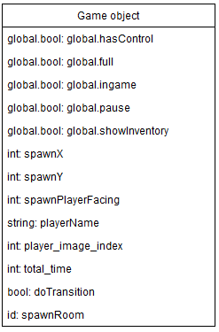
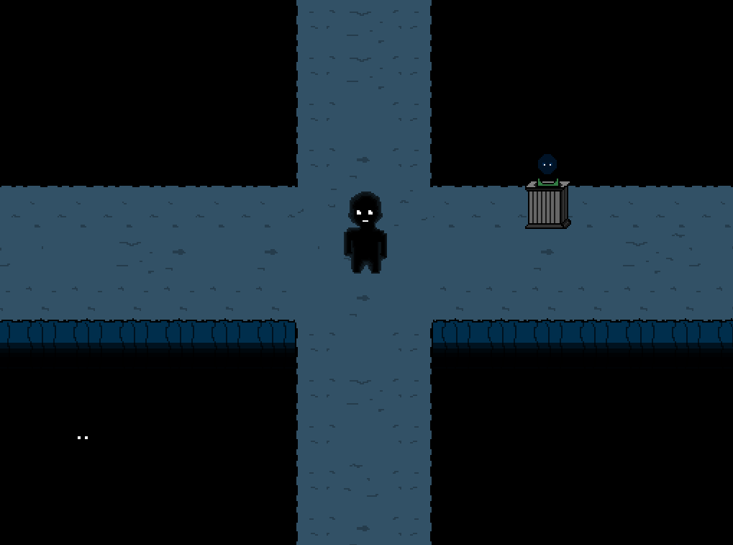
Main objects and systems implemented
Game object

Slide 22
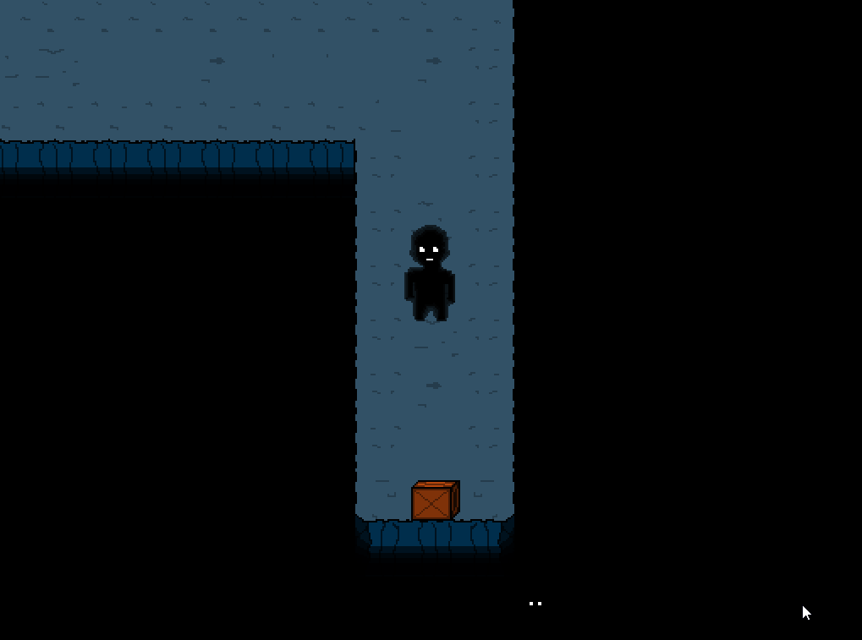
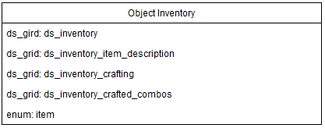
Main objects and systems implemented
Inventory object

Slide 23
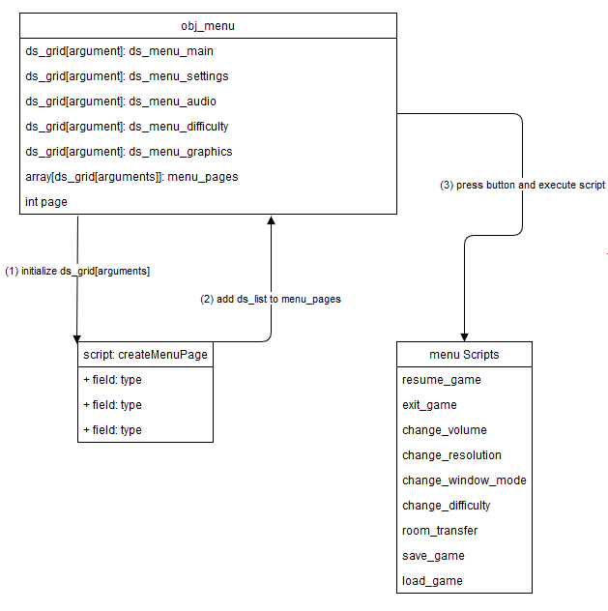
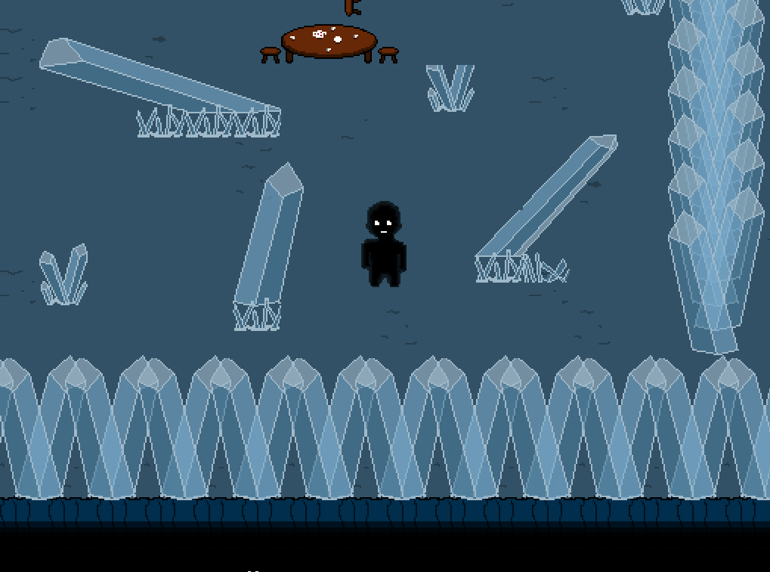
Main objects and systems implemented
Menu object

Slide 24
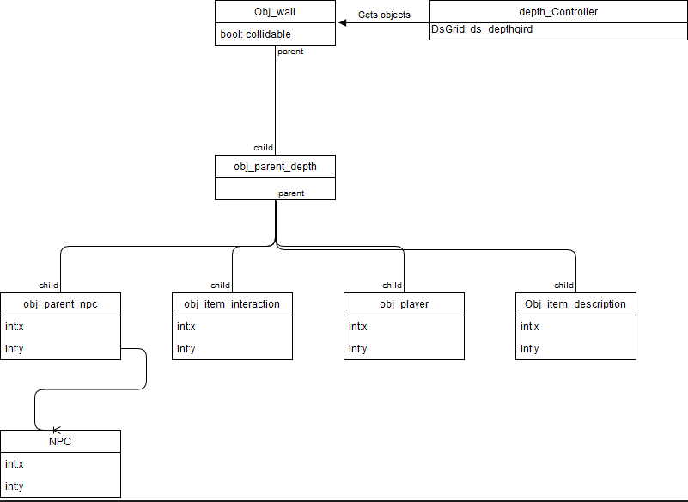
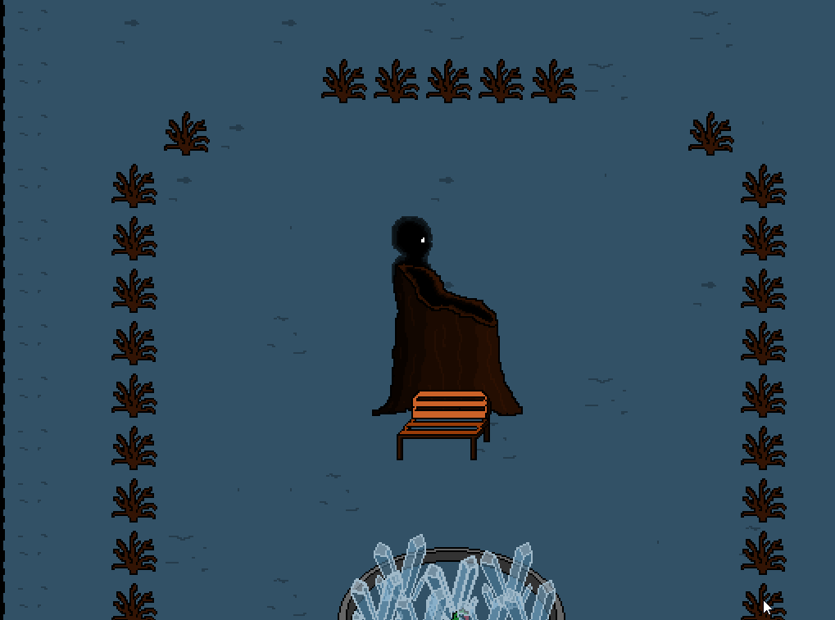
Main objects and systems implemented
Depth controller object

Slide 25
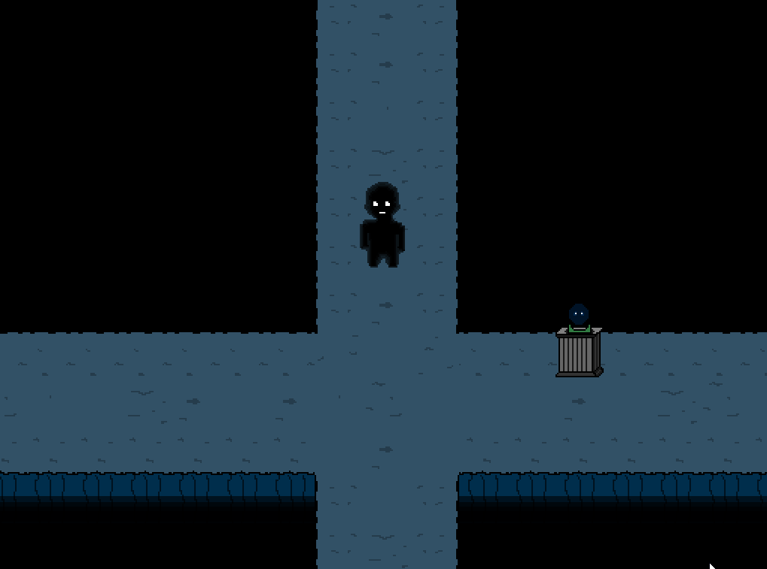
Main objects and systems implemented
Room transfer object

Slide 26
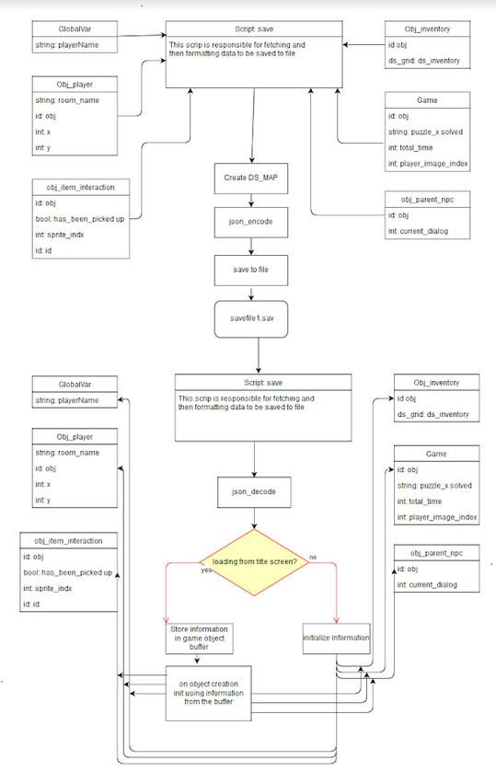
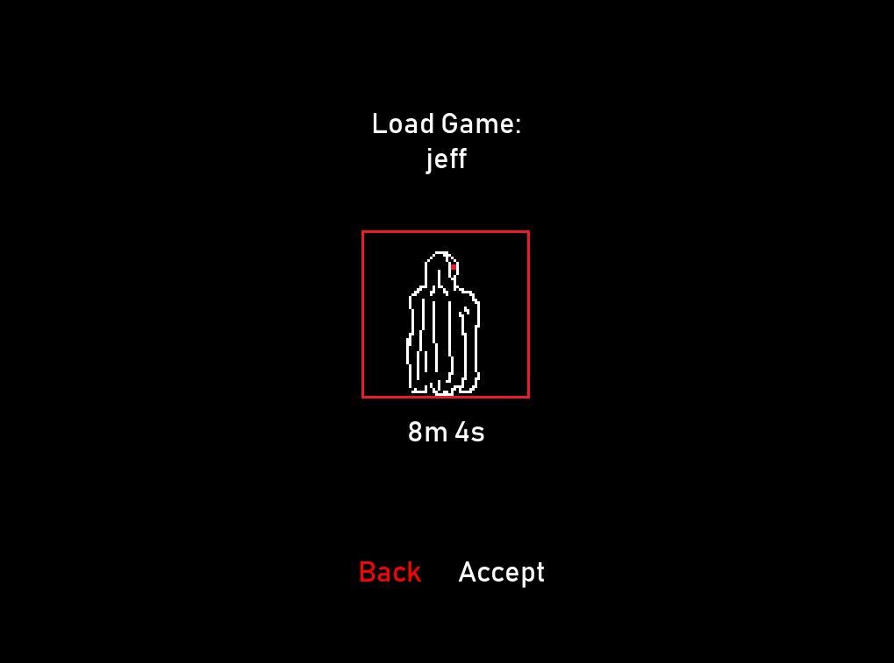
Main objects and systems implemented
Save load systems

Slide 27

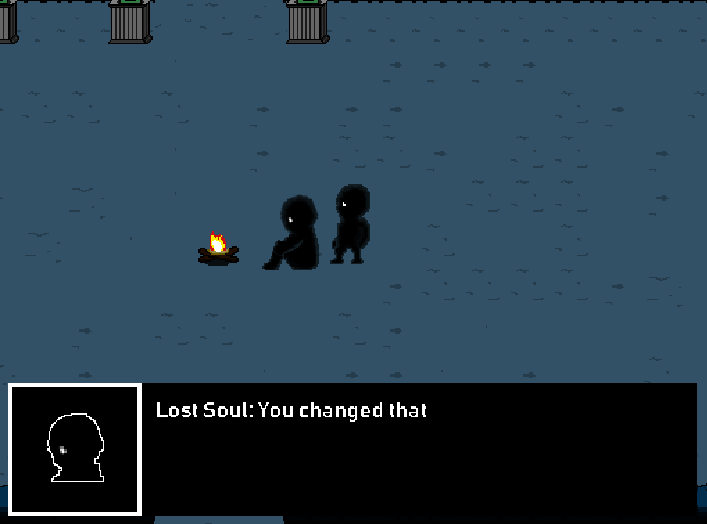
Main objects and systems implemented
Cutscene objects (including cutscene trigger object)

Slide 28
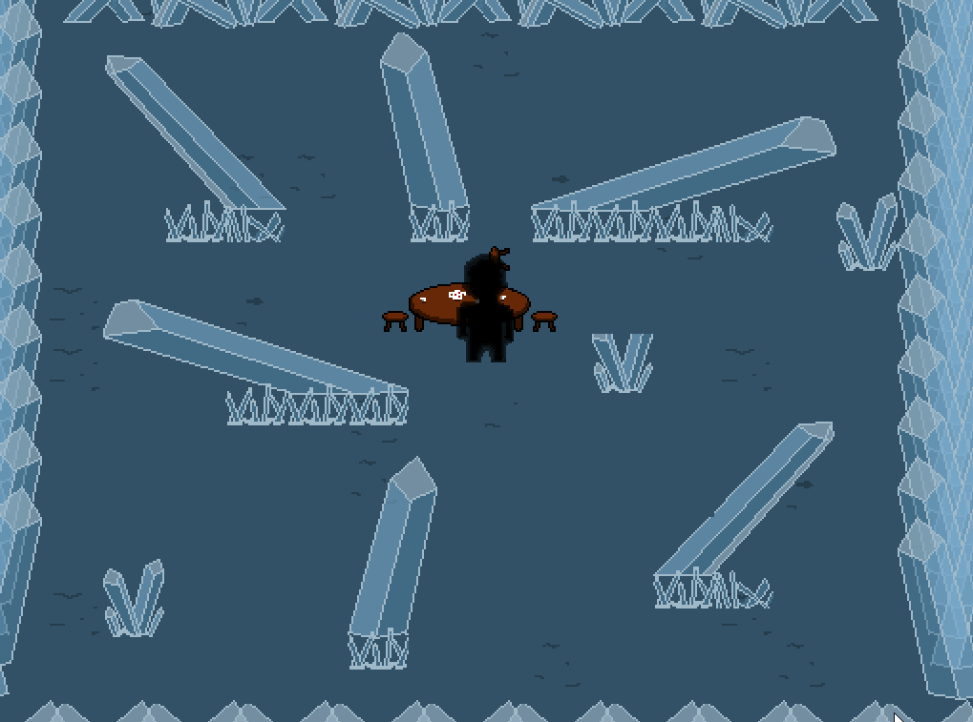
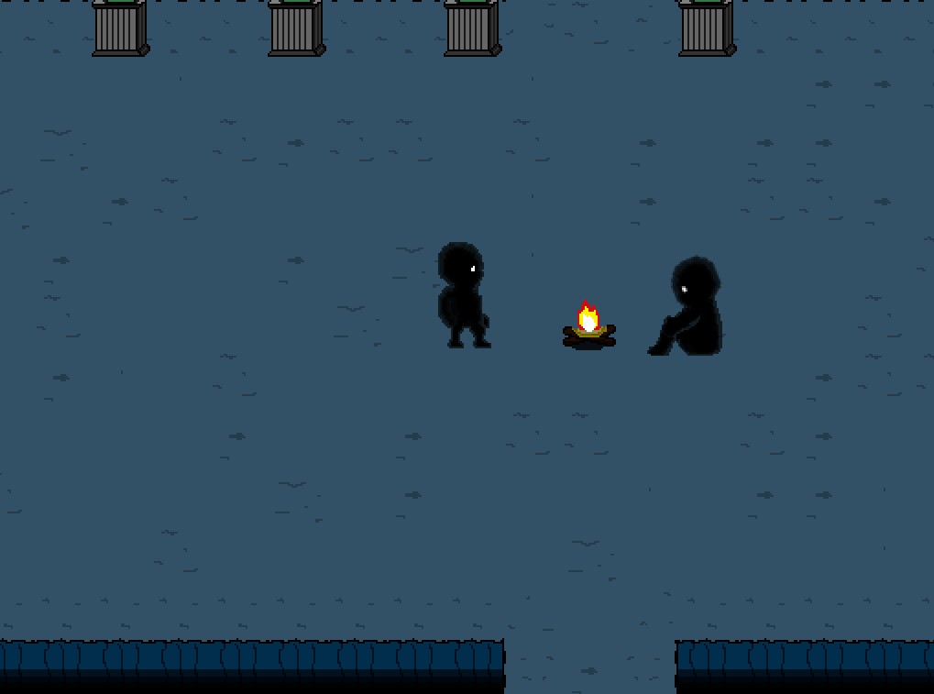
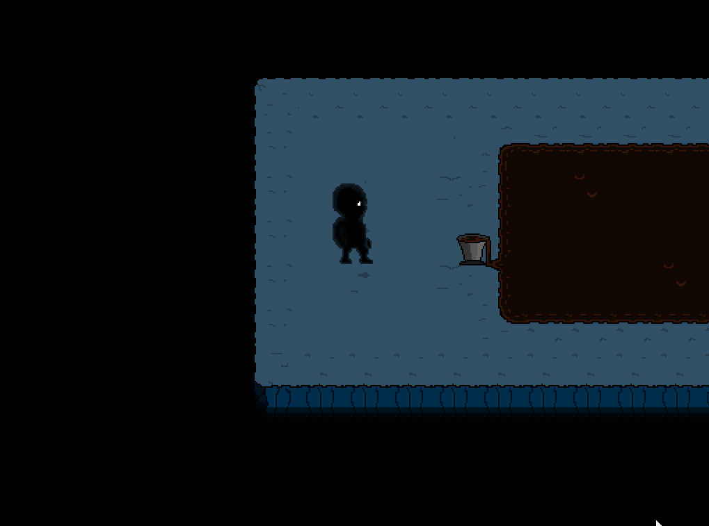
Main objects and systems implemented
Item interaction and item description objects

Slide 29
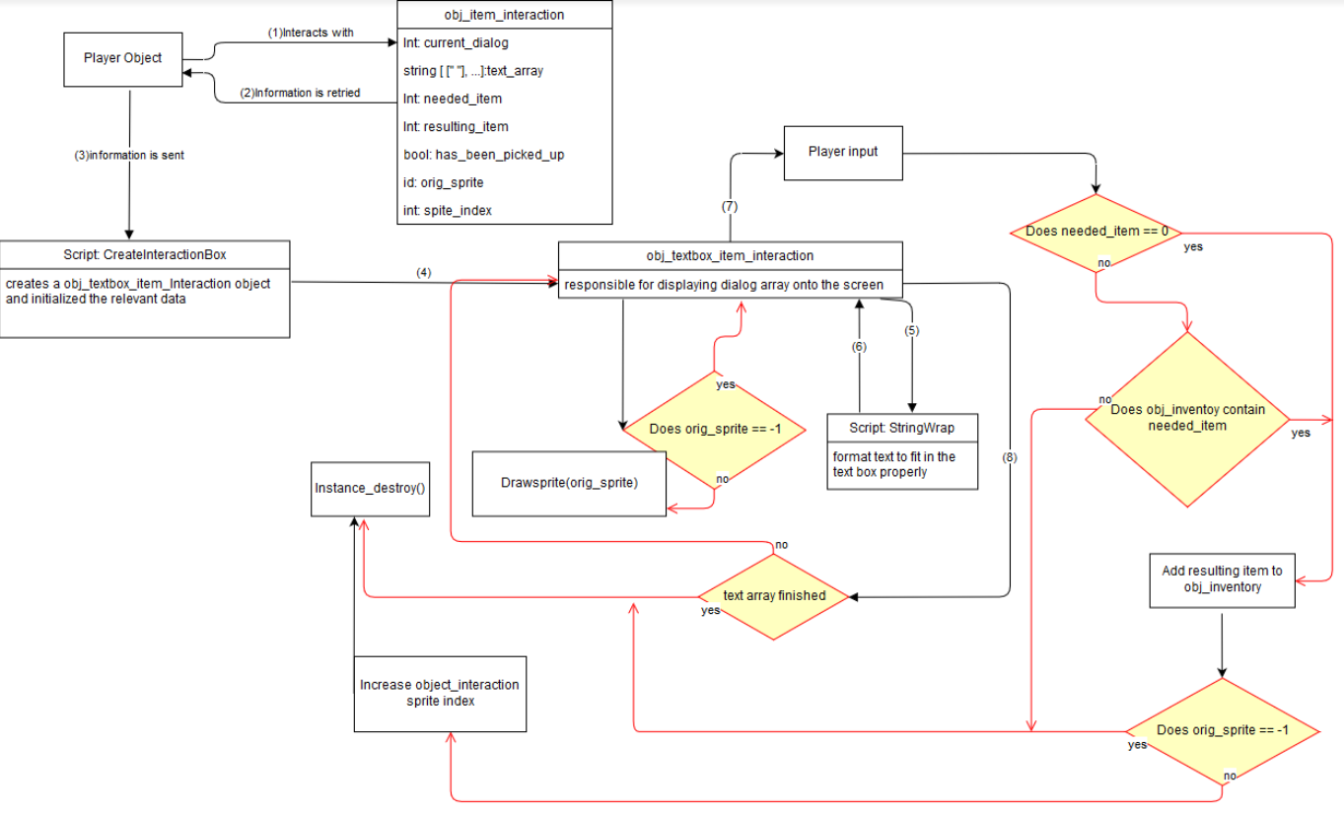
Main objects and systems implemented
Item interaction and item description objects

Slide 30
Demo
To see all these object and systems working in action come check out my station in the software and electronics project room to play the game.

Slide 31
Quick overview of Testing
Before the game had been created I set up where all the elements and outcomes for the first two puzzles were written on queue cards and then the tester attempted to solve the puzzle on their own and i would direct them. After that they gave feedback on the puzzles.

Slide 32
Quick overview of Testing
After the completion of each major object and system I created a list of manual tests for integration testing. Here is an example of a few tests I would check against for the saving system
Does saving in the room work?
Does loading from within a room work
Does loading with no save file cause no issues?
Does loading from title screen work properly
Do all obj_interaction instances contain the proper item status?
Do all obj_npc instances contain the proper dialog state?
Does the inventory contain the proper information after loading?

Slide 33
Quick overview of Testing
Had my roommates play the game these last two weeks and act as beta testers then document what bugs they found.

Slide 34
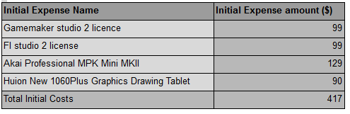
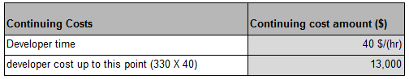
Costs
One time costs
Continuing costs

Slide 35
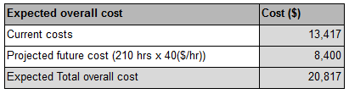
Costs
Expected costs

Slide 36
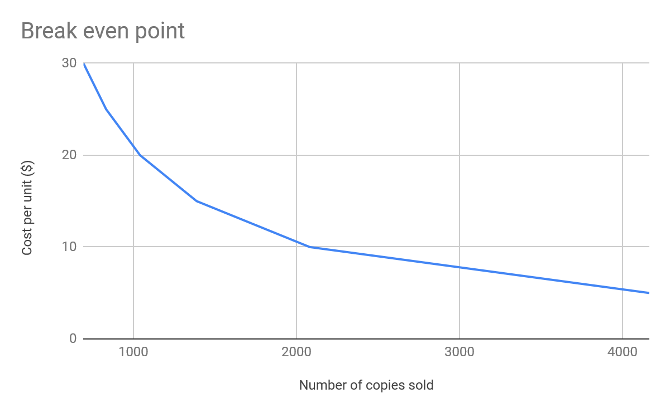
Potential Profit

Slide 37
What was proposed but not achieved
I had proposed to have completed 6 levels
Ended up have the first level completed and the second level ¾ completed.
This was due to unfamiliarity with the program.
Poor understanding of how long certain task would take to complete. I.e. i thought the save system would be able to be completed in under a week. Ended up taking over a month and a half to get it where it is currently.
Took longer to create objects that were scalable and more robust
Game music for each level and sound effects
Making music is easy, making good music is not so easy.
Ended up only having music for intro and title screen
Creating scenery takes a lot longer than you would think

Slide 38
Future goals for the game
Step 1
I want to complete the game.
Rough estimates that I have suggest that it would take maybe another 200 - 300 hours to finish.
Step 2
Put the game on steam

Slide 39
Questions ?

